Slide 1

MALLA REDDY COLLEGE OF ENGINEERING & TECHNOLOGY (Autonomous Institution – UGC, Govt. of India) DEPARTMENT OF COMPUTER SCIENCE AND ENGINEERING
AGRI AI:REVOLUTIONISING FARMING PRACTICES THROUGH MACHINE LEARNING ENABLED CROP GUIDANCE AND YIELD ESTIMATION
Batch No: C-20
Names with roll no: M.KARTHIK KUMAR (20N31A05F9)
M.SUKANYA (20N31A05G0)
MD ARSHAD BASHA (20N31A05E7)
P.VINAY REDDY (20N31A05H4)
Under the Guidance of
Name: Mr.SANDEEP AGARWALLA
Designation:ASSISTANT PROFESSOR

Slide 2
AGENDA
Introduction
Abstract
Existing system
Proposed system
Software and Hardware Requirements
Literature survey
System architecture(Modules Explanation)
UML Diagrams
Algorithms and technologies
Output screens/ Results
Conclusion
Future scope

Slide 3
INTRODUCTION
In recent years, agriculture has undergone a significant transformation propelled by advancements in technology and data-driven approaches. One such innovation that has gained momentum is the application of machine learning techniques in crop recommendation and yield prediction systems. With the world's population steadily increasing and agricultural land facing various challenges such as climate change and resource constraints, there is an urgent need for more efficient and sustainable agricultural practices.
This project focuses on developing a robust crop recommendation and yield prediction system using machine learning algorithms. By harnessing the power of data analytics and predictive modeling, this system aims to assist farmers, agronomists, and policymakers in making informed decisions to optimize agricultural productivity while minimizing resource inputs and environmental impact.

Slide 4
Abstract
Agriculture growth mainly depends on diverse soil parameters, namely Nitrogen, Phosphorus, Potassium, Crop rotation, Soil moisture, pH, surface temperature and weather aspects like temperature, rainfall, etc.
Technology will prove to be beneficial to agriculture which will increase crop productivity resulting in better yields to the farmer.
The proposed project provides a solution for Smart Agriculture by monitoring the agricultural field which can assist the farmers in increasing productivity to a great extent.
This work presents a system, in a form of a website, which uses Machine Learning techniques in order to predict the most profitable crop in the current weather and soil conditions. This system can also help in predicting the yield of the crop using weather parameter, soil parameter and historic crop yield.

Slide 5
Existing system
Manual observation and expeience
Traditional farming techniques
Weather forecasts
Pest and disease management
Limited technology
Information exchange

Slide 6
Proposed system
Data Availability
Model Complexity
Interpretability
Ethical Considerations
Performace monitoring and updates

Slide 7
Software and Hardware Requirements
HARDWARE REQUIREMENTS
Processor :
Intel i3 and above
RAM : 4GB
Higher Hard Disk : 500GB: Minimum
SOFTWARE REQUIREMENTS:
Programming Language :
Python IDE : PyCharm
UML Design : Start UML
Tools : PIP
WebServer : Tomcat
Framework : DJango,
Google Maps API Database : SQLite

Slide 8
Literature Survey
S.No | Author(s) & Journal Details | Title of the paper | Outcome
1 | D.Jayanarayana Reddy M. Rudra Kumar | Crop Yield Prediction using Machine Learning Algorithm | Agribusiness is the foundation of India's economy, with in excess of 50%of the populace occupied with cultivating. Environmental change,environmental change and other ecological variables altogether affect farming wellbeing. Machine learning (ML) assumes a significant part as itis an apparatus for Crop Yield Prediction (CYP) independent direction.
2 | Prof. Dr. Miklós Neményi | Crop Yield Prediction in Precision Agriculture | The prediction of crop yield is based on soil, meteorological,environmental, and cropparameters.Decision support models are broadlyused to extract significant crop features for prediction. Precisionagriculture focuses on monitoring (sensing technologies), management systems, variable rate technologies, and responses to inter- and intervisibility cropping systems.

Slide 9
3 | ZeelDoshi; Subhash Nadkarni; Rashi Agrawal | AgroConsultant: Intelligent Crop RecommendationSystem Using Machine Learning Algorithms | horticulture is a significant commitment to the Indian economy. The hugenumber of individuals living in India relies upon how they live in12 horticulture. Numerous Indian ranchers accept that they can pick plantsto plant at a given time.
4 | Jignasha M. Jethva, Nikhil Gondaliya, Vinita Shah | A Review on Data Mining Techniques for FertilizerRecommendation, | At the point when the dirt is insufficient in supplements, add compost todecrease it. A typical issue in farming is excrement determination andfertilizer expansion. Extreme development or absence of manure canharm vegetation and diminish efficiency. This record sums up thedifferent techniques for removing information used to develop abunch ofmodern manure soils.
5 | : M.C.S.Geetha | A Survey on Data Mining Techniques in Agriculture, 2015 | . It likewise checks out various methods of acquiring data to resolvenumerous agrarian issues. This paper integrates the work of severalauthors in a single place so it is valuable for specialists to get data ofcurrent situation of data mining systems and applications in context tofarming field.

Slide 10
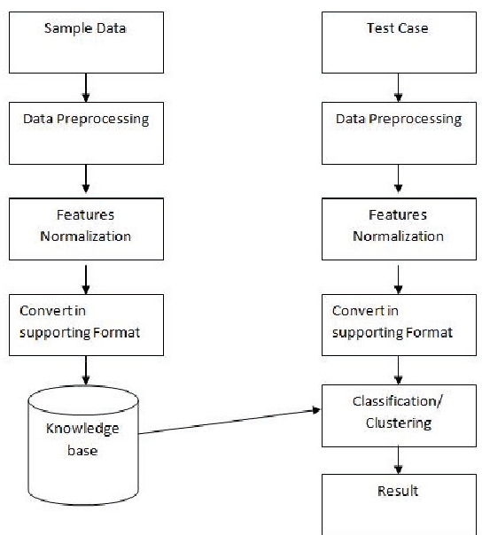
System Architecture

Slide 11
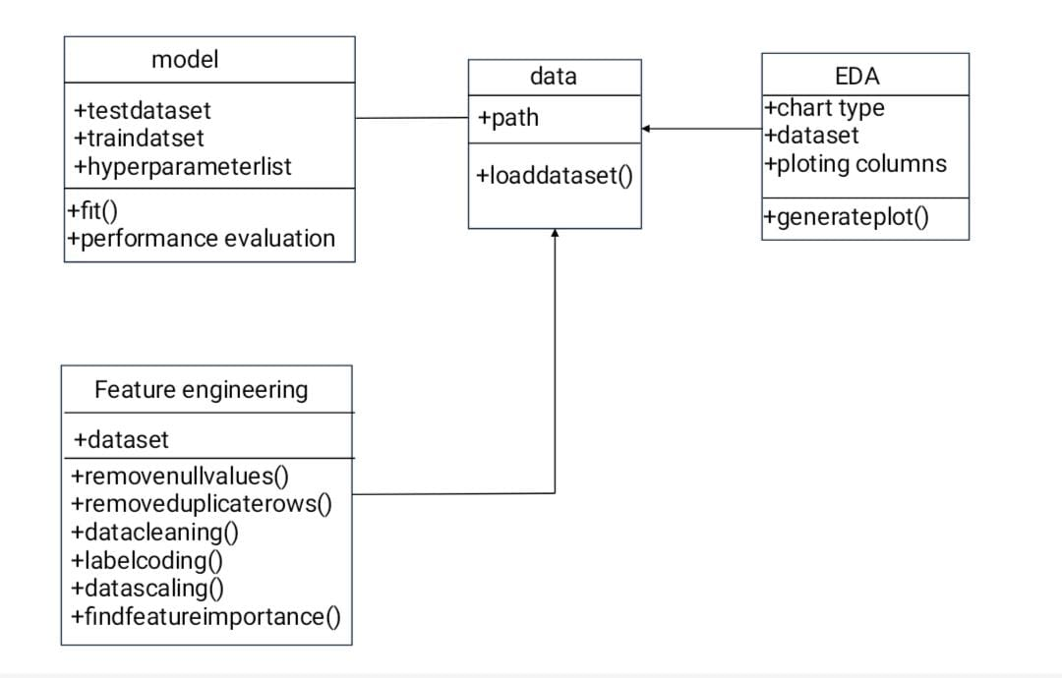
UML Diagrams
CLASS DIAGRAM

Slide 12
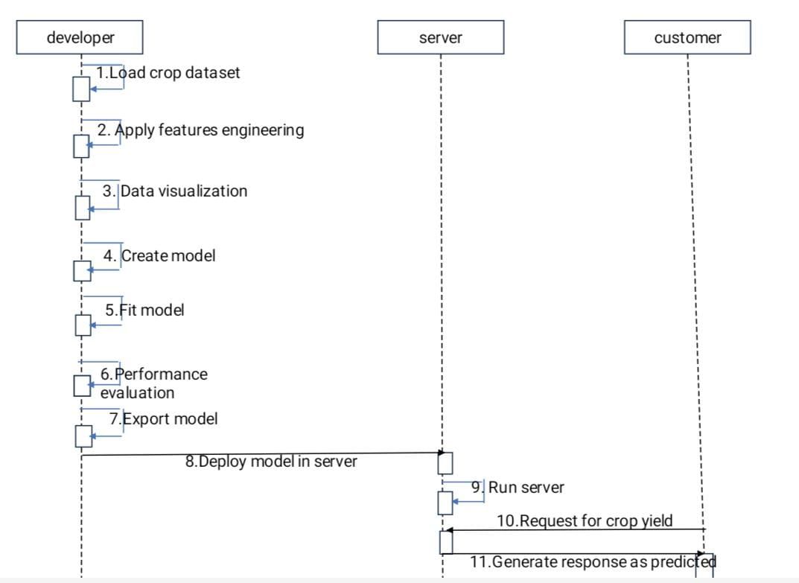
SEQUENCE DIAGRAM

Slide 13
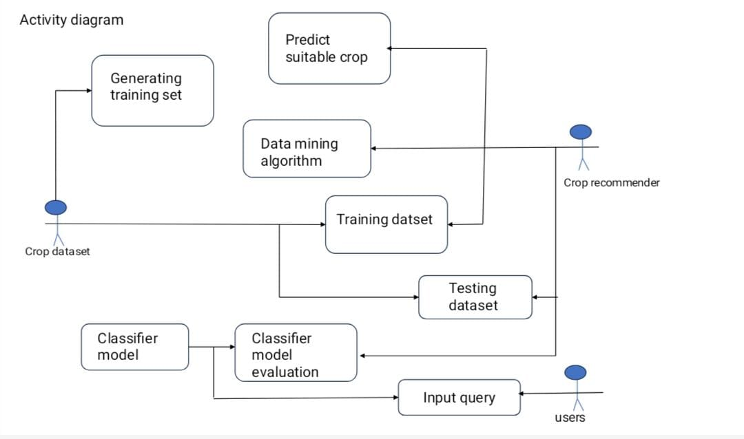




ACTIVITY DIAGRAM

Slide 14
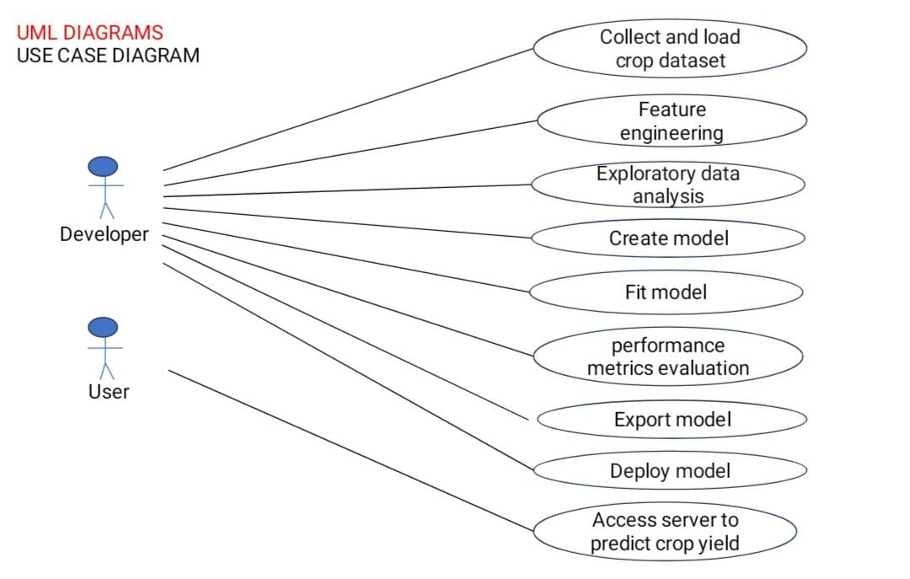



USECASE DIAGRAM

Slide 15
Algorithms and Technologies
ALGORITHMS USED
1. Crop Recommendation:
- Decision Trees
- Random Forest
2. Yield Prediction:
- Linear Regression
TECHNOLOGIES USED
1. Python
2. scikit-learn (sklearn)
3. TensorFlow
4. Keras
5. Pandas
6. NumPy
7. Matplotlib
8. Seaborn
9. Flask or Django (for web development)
10. SQL or NoSQL databases

Slide 16
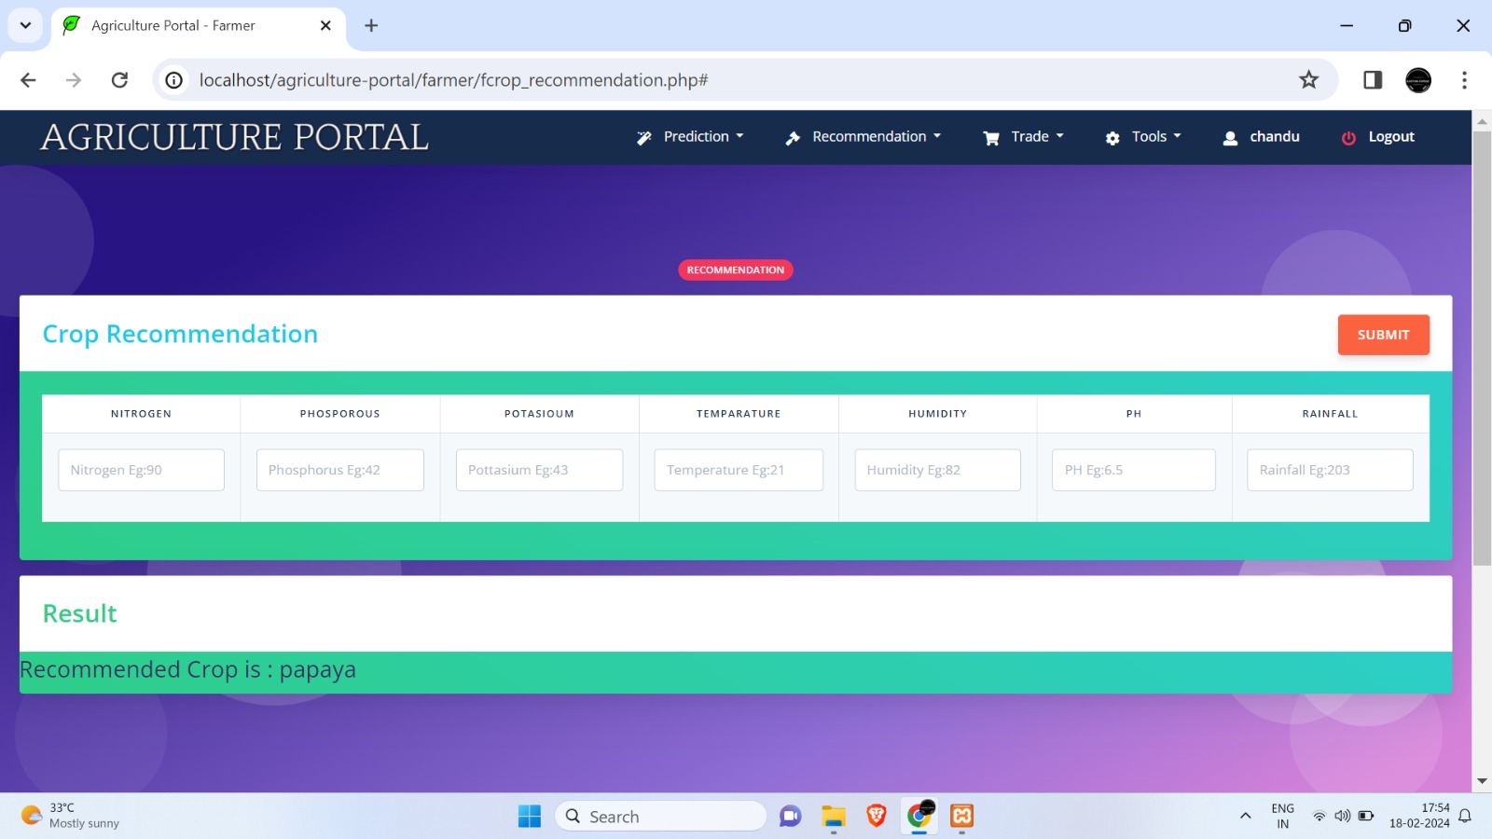
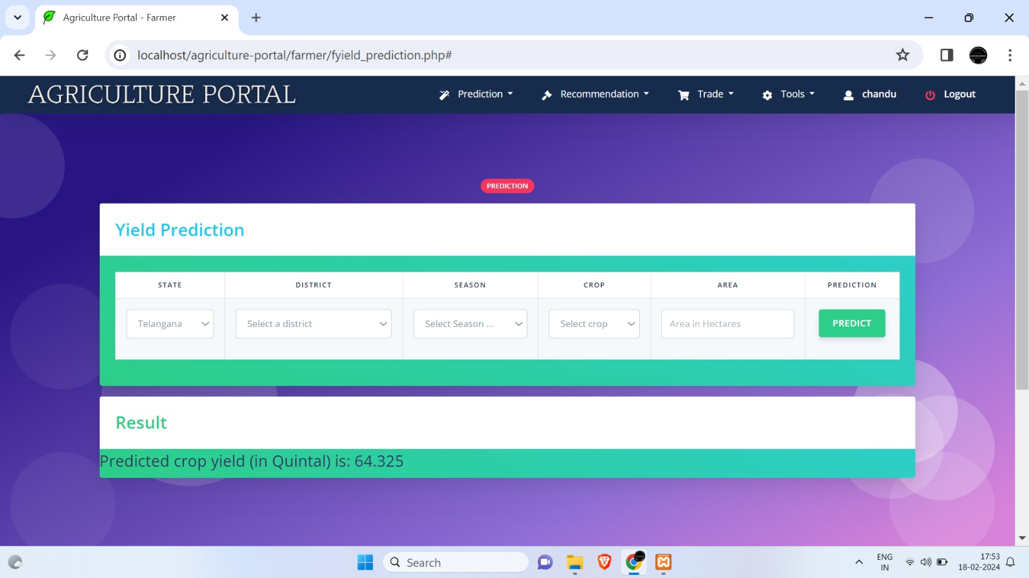
Output Screens

Slide 17

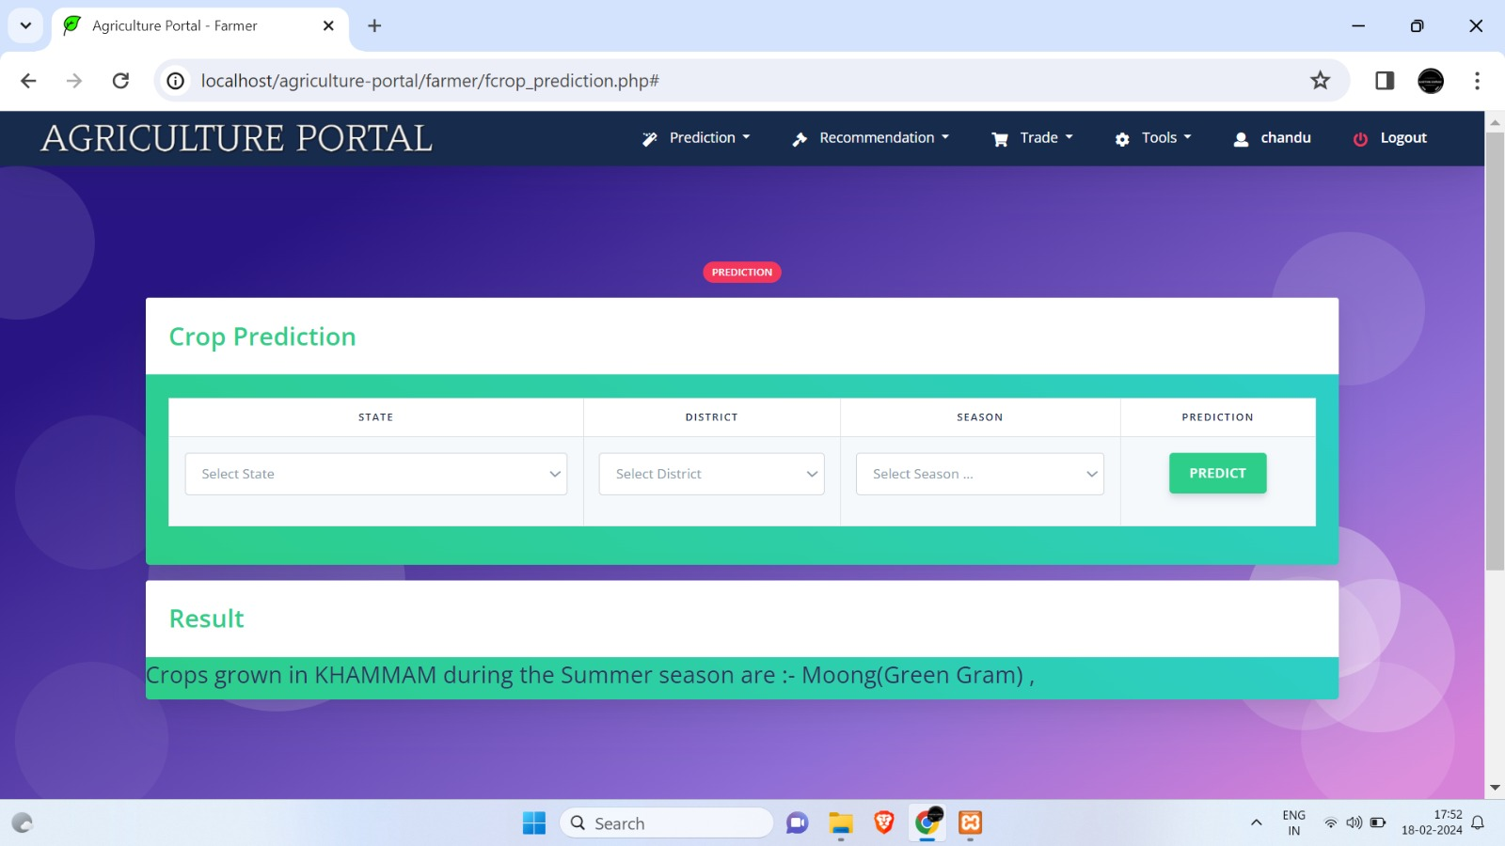
Output Screens

Slide 18
Conclusion
In conclusion, the project focusing on crop recommendation and yield prediction through machine learning offers a promising solution to address the complexities of modern agriculture. By harnessing the power of advanced algorithms and data-driven insights, the project aims to optimize crop selection, management practices, and productivity for farmers worldwide. Through extensive data collection, preprocessing, and model development, the system provides personalized recommendations and accurate yield predictions tailored to specific environmental conditions and user preferences.

Slide 19
Future Scope
It involves collecting diverse datasets containing information on historical crop yields, soil attributes, weather patterns, crop varieties, and agricultural practices.
Data preprocessing.
Feature selection Evaluating model performance
potentially creating a user interface for farmer interaction,
Ensuring adaptability to diverse regions and scalability for different crops are also within the scope.

Slide 20
Reference
[1] Manpreet Kaur, Heena Gulati, Harish Kundra, “Data Mining in Agriculture on Crop Price Prediction: Techniques and Applications”, International Journal of Computer Applications, Volume 99– No.12, August 2014.
[2] J. Meng, “Research on the cost of agricultural products circulation and its control under the new normal economic development,” Commercial Times, no. 23, pp. 145147, 2016.
[3] A. Kaloxylos et al., “Farm management systems and the future Internet era,” Comput. Electron. Agriculture., vol. 89, pp. 130–144, Nov. 2012.
[4] N. N. Li, T. S. Li, Z. S. Yu, Y. Rui, Y. Y. Miao, and Y. S. Li, “Factors influencing farmers’ adoption of new technology based on Logistic-ISM model-a case study of potato planting technology in Dingxi City, Gansu Province,” Progress in Geography, vol. 33, no. 4, pp. 542-551, 2014.
[5] Y. Wang, "A neural network adaptive control based on rapid learning method and its application," Advances In Modeling and Analysis, Vol. 46(3), pp. 27-34,199

Slide 21
THANKYOU

